Slide 1
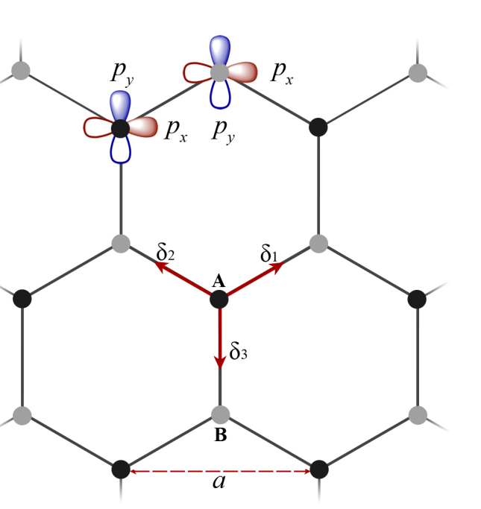
对于这个体系，文章只考虑了最近邻
首先定义两个跃迁系数，分别为$t_{∥}$和$t_{⊥}，$对于A和B原子，都有三个最近邻，两个原子的在位能项设为相反数
A和B如果刚好头碰头则设为$t_{∥}$，现在变成了分量
其中，第一个原子的px轨道到第二个原子的px轨道之间的跃迁如下：
$$H_{13}=t_{∥}e^{i2π\left(k_{x}∗\frac{1}{2}+k_{y}∗\frac{1}{2\sqrt{3}}\right)}∗\frac{\sqrt{3}}{2}∗\frac{\sqrt{3}}{2}+t_{∥}e^{i2π\left({−k}_{x}∗\frac{1}{2}+k_{y}∗\frac{1}{2\sqrt{3}}\right)}∗\frac{\sqrt{3}}{2}∗\frac{\sqrt{3}}{2}$$
$$+t_{⊥}e^{i2π\left(k_{x}∗\frac{1}{2}+k_{y}∗\frac{1}{2\sqrt{3}}\right)}∗\frac{1}{2}∗\frac{1}{2}+t_{⊥}e^{i2π\left({−k}_{x}∗\frac{1}{2}+k_{y}∗\frac{1}{2\sqrt{3}}\right)}∗\frac{1}{2}∗\frac{1}{2}$$
$$+t_{⊥}e^{i2π\left(−k_{y}∗\frac{1}{\sqrt{3}}\right)}$$
A原子的px到B原子的py
$$H_{14}=t_{∥}e^{i2π\left(k_{x}∗\frac{1}{2}+k_{y}∗\frac{1}{2\sqrt{3}}\right)}∗\frac{\sqrt{3}}{2}∗\frac{1}{2}−t_{∥}e^{i2π\left({−k}_{x}∗\frac{1}{2}+k_{y}∗\frac{1}{2\sqrt{3}}\right)}∗\frac{1}{2}∗\frac{\sqrt{3}}{2}$$
$$−t_{⊥}e^{i2π\left(k_{x}∗\frac{1}{2}+k_{y}∗\frac{1}{2\sqrt{3}}\right)}∗\frac{\sqrt{3}}{2}∗\frac{1}{2}+{t_{⊥}e}^{i2π\left({−k}_{x}∗\frac{1}{2}+k_{y}∗\frac{1}{2\sqrt{3}}\right)}∗\frac{1}{2}∗\frac{\sqrt{3}}{2}$$
$$p_{x}$$
$$p_{x}$$
注意这里加了负号，因为这里考虑了头碰头和肩并肩的方向！！！

Slide 2
A原子的py到B原子的px
$$H_{23}=t_{∥}e^{i2π\left(k_{x}∗\frac{1}{2}+k_{y}∗\frac{1}{2\sqrt{3}}\right)}∗\frac{\sqrt{3}}{2}∗\frac{1}{2}−t_{∥}e^{i2π\left({−k}_{x}∗\frac{1}{2}+k_{y}∗\frac{1}{2\sqrt{3}}\right)}∗\frac{1}{2}∗\frac{\sqrt{3}}{2}$$
$$−t_{⊥}e^{i2π\left(k_{x}∗\frac{1}{2}+k_{y}∗\frac{1}{2\sqrt{3}}\right)}∗\frac{\sqrt{3}}{2}∗\frac{1}{2}+{t_{⊥}e}^{i2π\left({−k}_{x}∗\frac{1}{2}+k_{y}∗\frac{1}{2\sqrt{3}}\right)}∗\frac{1}{2}∗\frac{\sqrt{3}}{2}=H_{14}$$
A原子的py到B原子的py
$$H_{24}=t_{∥}e^{i2π\left(k_{x}∗\frac{1}{2}+k_{y}∗\frac{1}{2\sqrt{3}}\right)}∗\frac{1}{2}∗\frac{1}{2}+t_{∥}e^{i2π\left({−k}_{x}∗\frac{1}{2}+k_{y}∗\frac{1}{2\sqrt{3}}\right)}∗\frac{1}{2}∗\frac{1}{2}$$
$$+t_{⊥}e^{i\left(k_{x}∗\frac{1}{2}+k_{y}∗\frac{1}{2\sqrt{3}}\right)}∗\frac{\sqrt{3}}{2}∗\frac{\sqrt{3}}{2}+t_{⊥}e^{i\left({−k}_{x}∗\frac{1}{2}+k_{y}∗\frac{1}{2\sqrt{3}}\right)}∗\frac{\sqrt{3}}{2}∗\frac{\sqrt{3}}{2}$$
$$+t_{∥}e^{i\left(−k_{y}∗\frac{1}{\sqrt{3}}\right)}$$
$$p_{x}$$
最终得到的哈密顿量
$$H=\left(\begin{matrix}\begin{matrix}λ & 0 \\ 0 & λ\end{matrix} & \begin{matrix}H_{13} & H_{14} \\ H_{23} & H_{24}\end{matrix} \\ \begin{matrix}H_{13}^{∗} & H_{23}^{∗} \\ H_{14}^{∗} & H_{24}^{∗}\end{matrix} & \begin{matrix}−λ & 0 \\ 0 & −λ\end{matrix}\end{matrix}\right)$$

